Slide 1
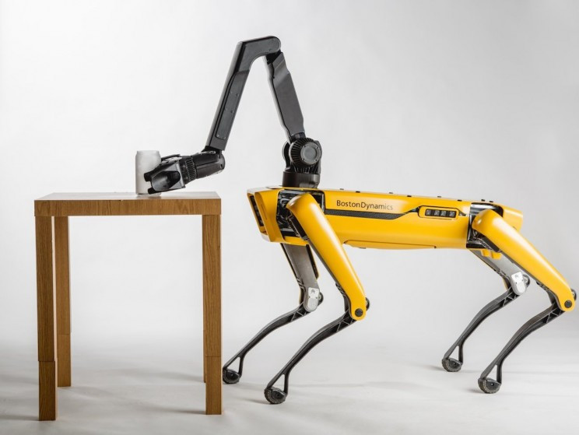
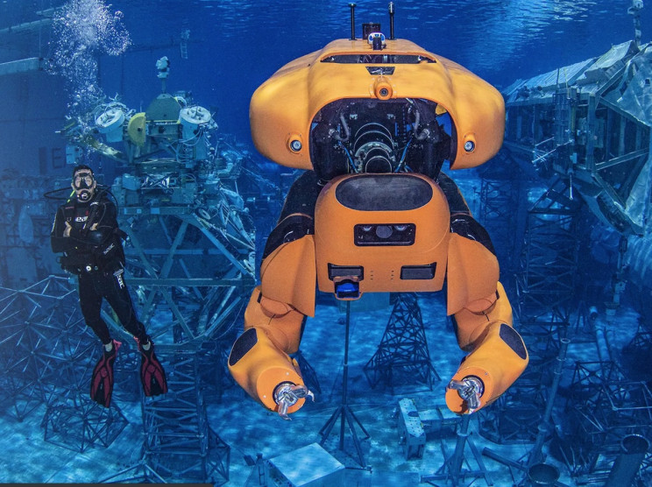
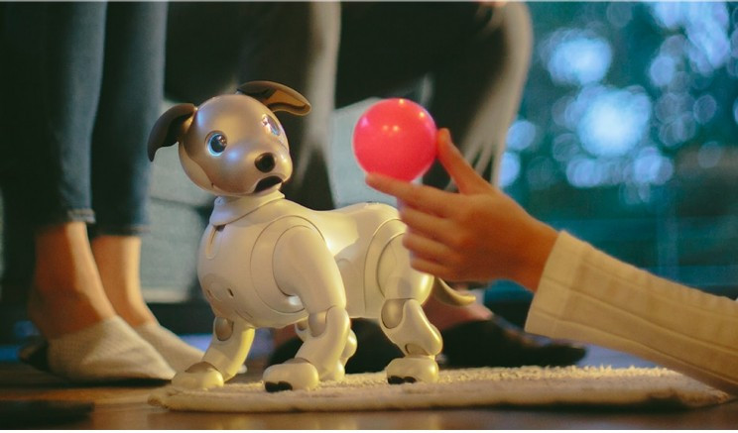
Robots
Filimonov Stepan RL6-31

Slide 2
The Transforming aquatic robot for underwater missions.
Created by Houston Mechatronics, the aquanaut is a robot in a class of its own. It has the unique ability to transform while underwater, moving from an autonomous submersible vehicle(AUV), into a humanoid maintenance robot(ROV).

Slide 3
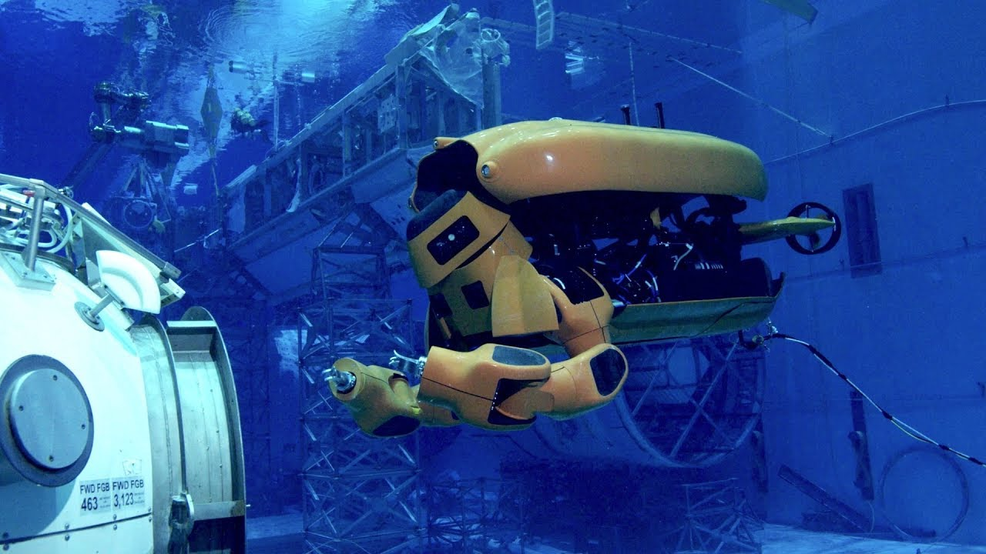
In its AUV mode, it can cover up to 124 miles (200km) on one mission, completing tasks like seabed mapping and wide-area inspection. While in ROV mode, two mechanical arms come out of its body, giving it the ability to conduct repairs on oil rigs and pipelines in hazardous environments not easily accessible by humans.

Slide 4
A pack of wild Sony Aibo dogs could chase you around the city.
robot dogs are unbelievably adorable. Sony's Aibo is a robotic dog that has been wildly popular over the years. The robotic dog is actually a hybrid between a pet and a toy. Since its first appearance in 2018, the robot dog has gotten much smarter, thanks to artificial intelligence.

Slide 5

Similar to your real-life furry best friend, Aibo can recognize its owner. Think Pinocchio, but as a robot dog. And this may come to fruition sooner than you think. The AI algorithms that give the dogs their intelligence are kept in the cloud. This allows active Aibos to learn collectively, meaning they can all learn from each other.

Slide 6
Actually, getting chased down by a pack of Boston Dynamics' Spot robots is much scarier.
Boston Dynamics had to make this list. Their somewhat dog-like SPOT robot recently entered the market. But the nimble, canine-like intelligent robot has been in the public eye for a while. SPOT is not a pet or a toy like the Sony Aibo. Starting at about $70,000, the robot can "traverse through rough terrain with unprecedented ease" but is small enough to use indoors, making it extremely versatile.

Slide 7
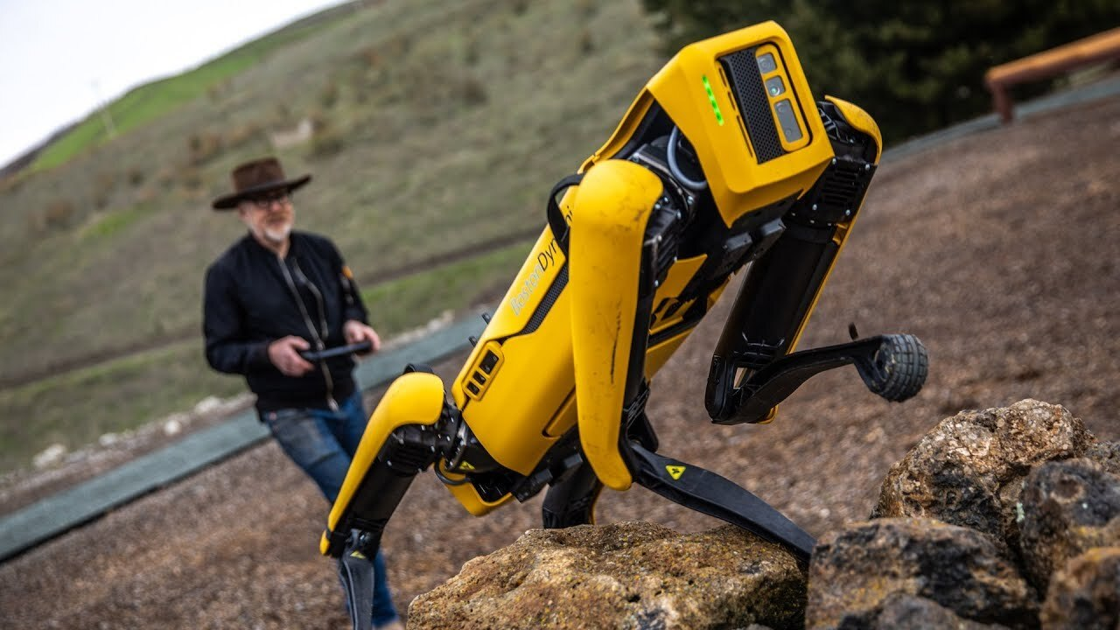
It features a 360-degree vision and obstacle avoidance. The robot can either be taught actions or use pre-planned routes to perform autonomous missions. It can also carry various payloads. You might one day see SPOT on a construction site, inspecting oil and gas facilities, checking mining routes, or being used to deliver supplies to medical professionals. See SPOT run.

Slide 8


